Slide 1
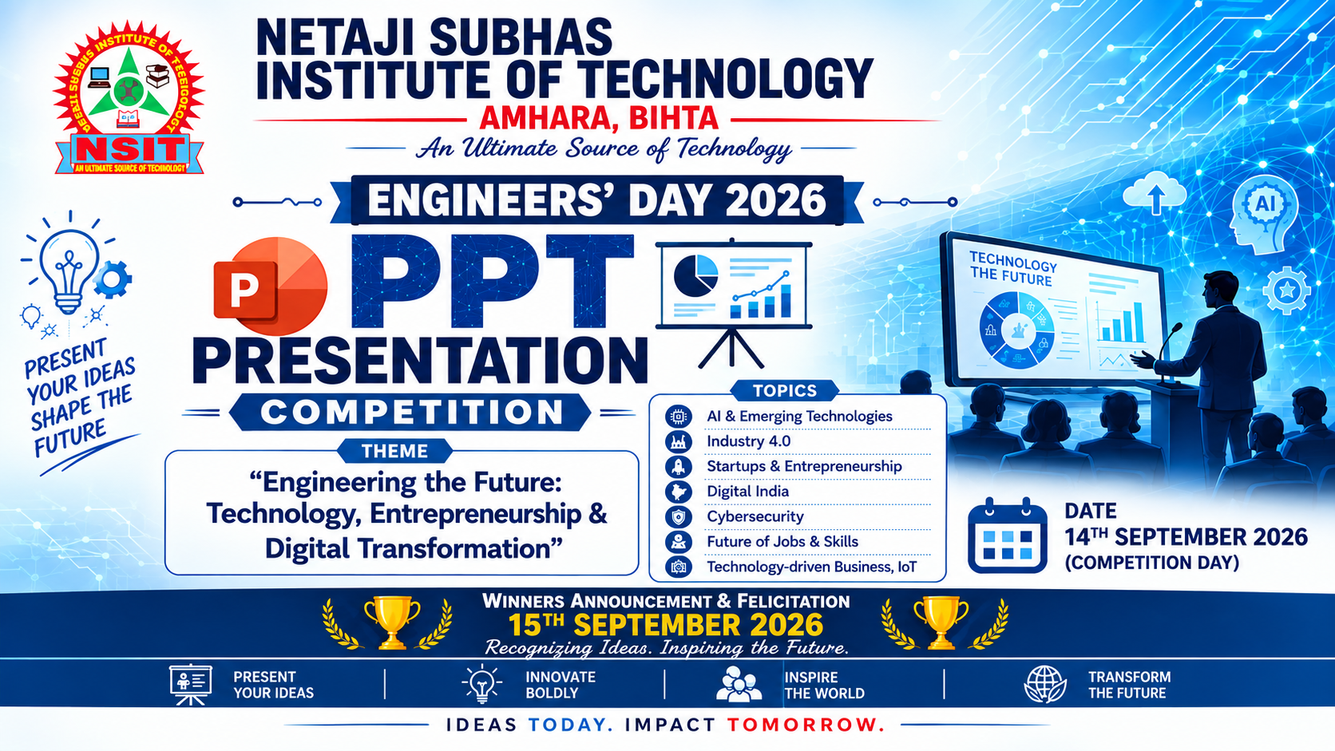

Slide 2


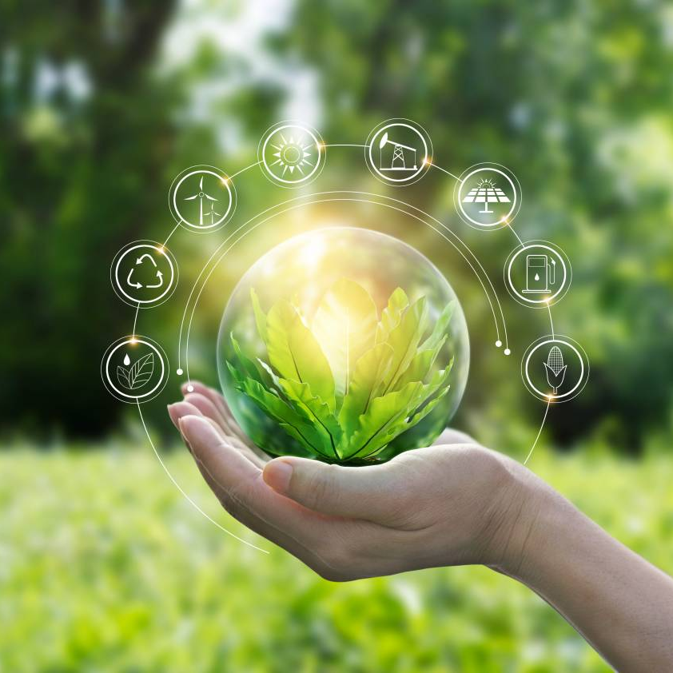

NETAJI SUBHAS INSTITUTE OF TECHNOLOGY
GREEN
TECHNOLOGY
Presented by:
Nandini Chandra (261132)
Laxmi Kumari (261136)
Sakshi Kumari (261128)

Slide 3
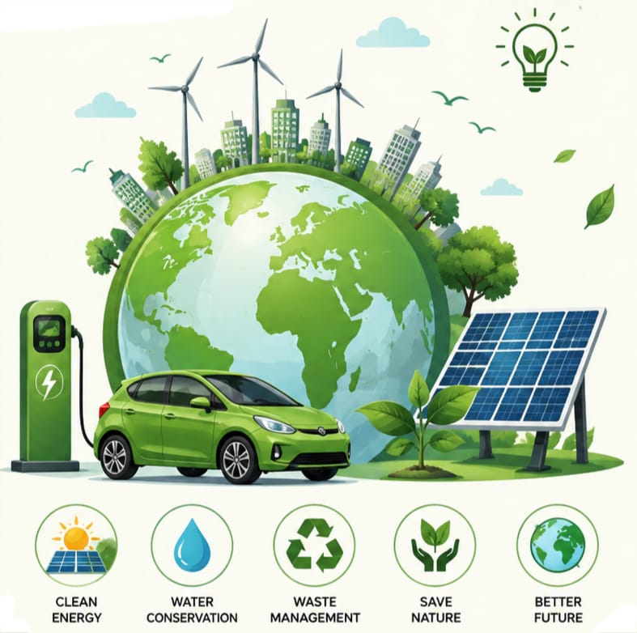
INTRODUCTION
Technology for a Cleaner, Greener & Sustainable future !
Green technology refers to eco-friendly technologies that reduce harm to the environment.
It is a system that uses innovative methods to create an environmental friendly products.
Green technology uses clean and sustainable solutions to protect the environment.

Slide 4





NEEDS OF GREEN TECHNOLOGY
Tackles climatic
change
Supports sustainable
growth
Conserves Natural Resources
Provides clean energy
Improves human health

Slide 5

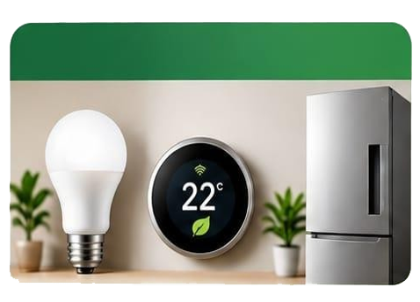
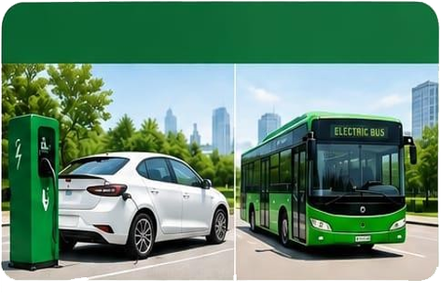

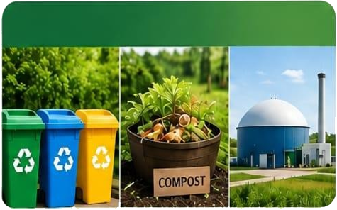

TYPES OF GREEN TECHNOLOGY
1. Renewable Energy
2. Energy Effeciency
3. Green Transpotation
4. Waste Management
5. Water Conversation
6. Green Buildings

Slide 6





THE 5 CORE GOALS
REDUCE
REUSE
RECYCLE
RESTORE
RENEW

Slide 7
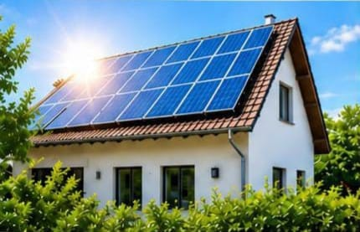
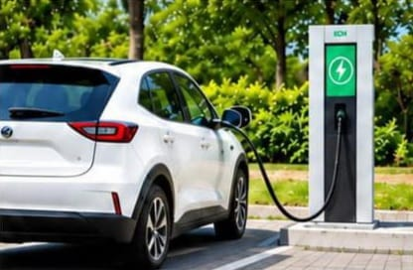
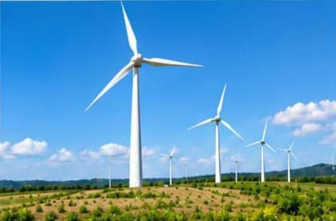
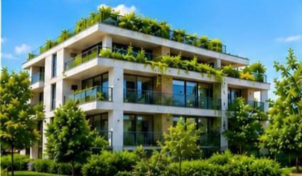
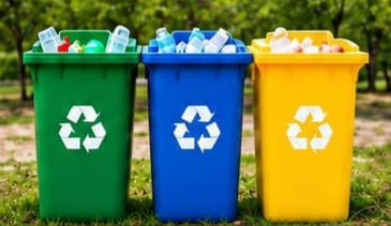
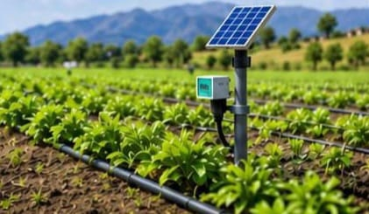
REAL LIFE APPPLICATONS
Solar Energy
Electric Vehicles
Wind Energy
Green Buildings
Recycling & Waste
Smart Agriculture

Slide 8

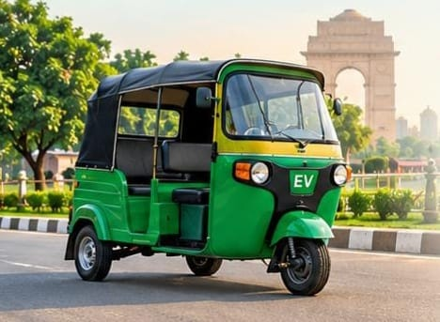
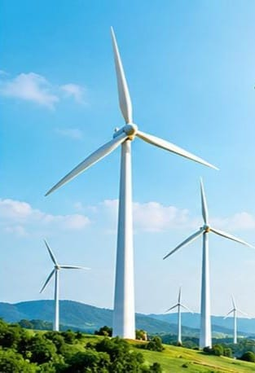

GREEN TECHNOLOGY IN INDIA
~India’s solar capacity is growing past.
~Bhadla Solar Park is one of the world’s largest.
~Clean, renewable & scalable energy.
~Over 1.5 million e-rickshaws in India.
~Reduces air pollution in cities
~Affordable, eco-friendly & convenient.
~India’s wind capacity is expanding rapidly.
~Tamil Nadu, Gujarat, Maharashtra are key states.
~Clean energy for a sustainable future.
~Produces hydrogen using renewable energy.
~Target: 5MMT production by 2030
~Supports clean industry, transport & fuel.

Slide 9

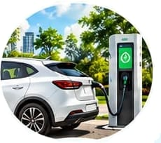
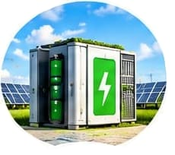



CHALLENGES
FUTURE
Smarter Transportation
High Initial Costs
Energy Storage
Sustainable Living
Technology & Infrastructure
A Healthier Planet

Slide 10
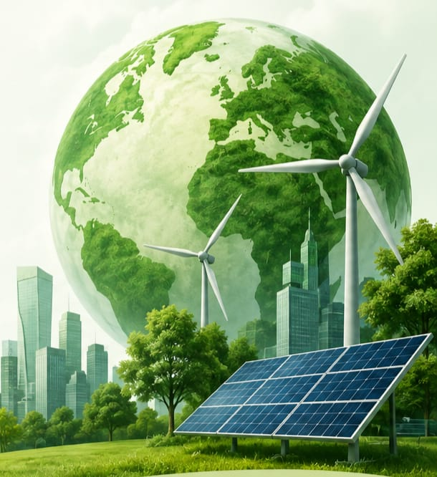
CONCLUSION
Green Technology is the key to a sustainable & better future for our planet.
It reduces pollution, conserves natural resources & supports economic growth.
It promotes clean energy, creates green jobs, & supports economic growth.
By adopting it we can build a cleaner, healthier & more resilient world
The future is in our hands ---- let’s choose green today for a brighter tomorrow !

Slide 11
Thank
You !

Slide 12


